Slide 1
Smart Learning Companion: A Dual-AI Assessment System
Prepared to:
Dr. Mohammad Aoude
Student:
Jana Shbib 6007

Slide 2
Project overview
Objective: "Develop an AI-powered educational tool that evaluates critical thinking skills using both rule-based and ML approaches."
Key Features: ✅ Dynamic test generation with Open Router API ✅ Dual scoring system (Rule-based + Random Forest) ✅ Interactive dashboard with performance analytics ✅ Dockerized microservices architecture

Slide 3
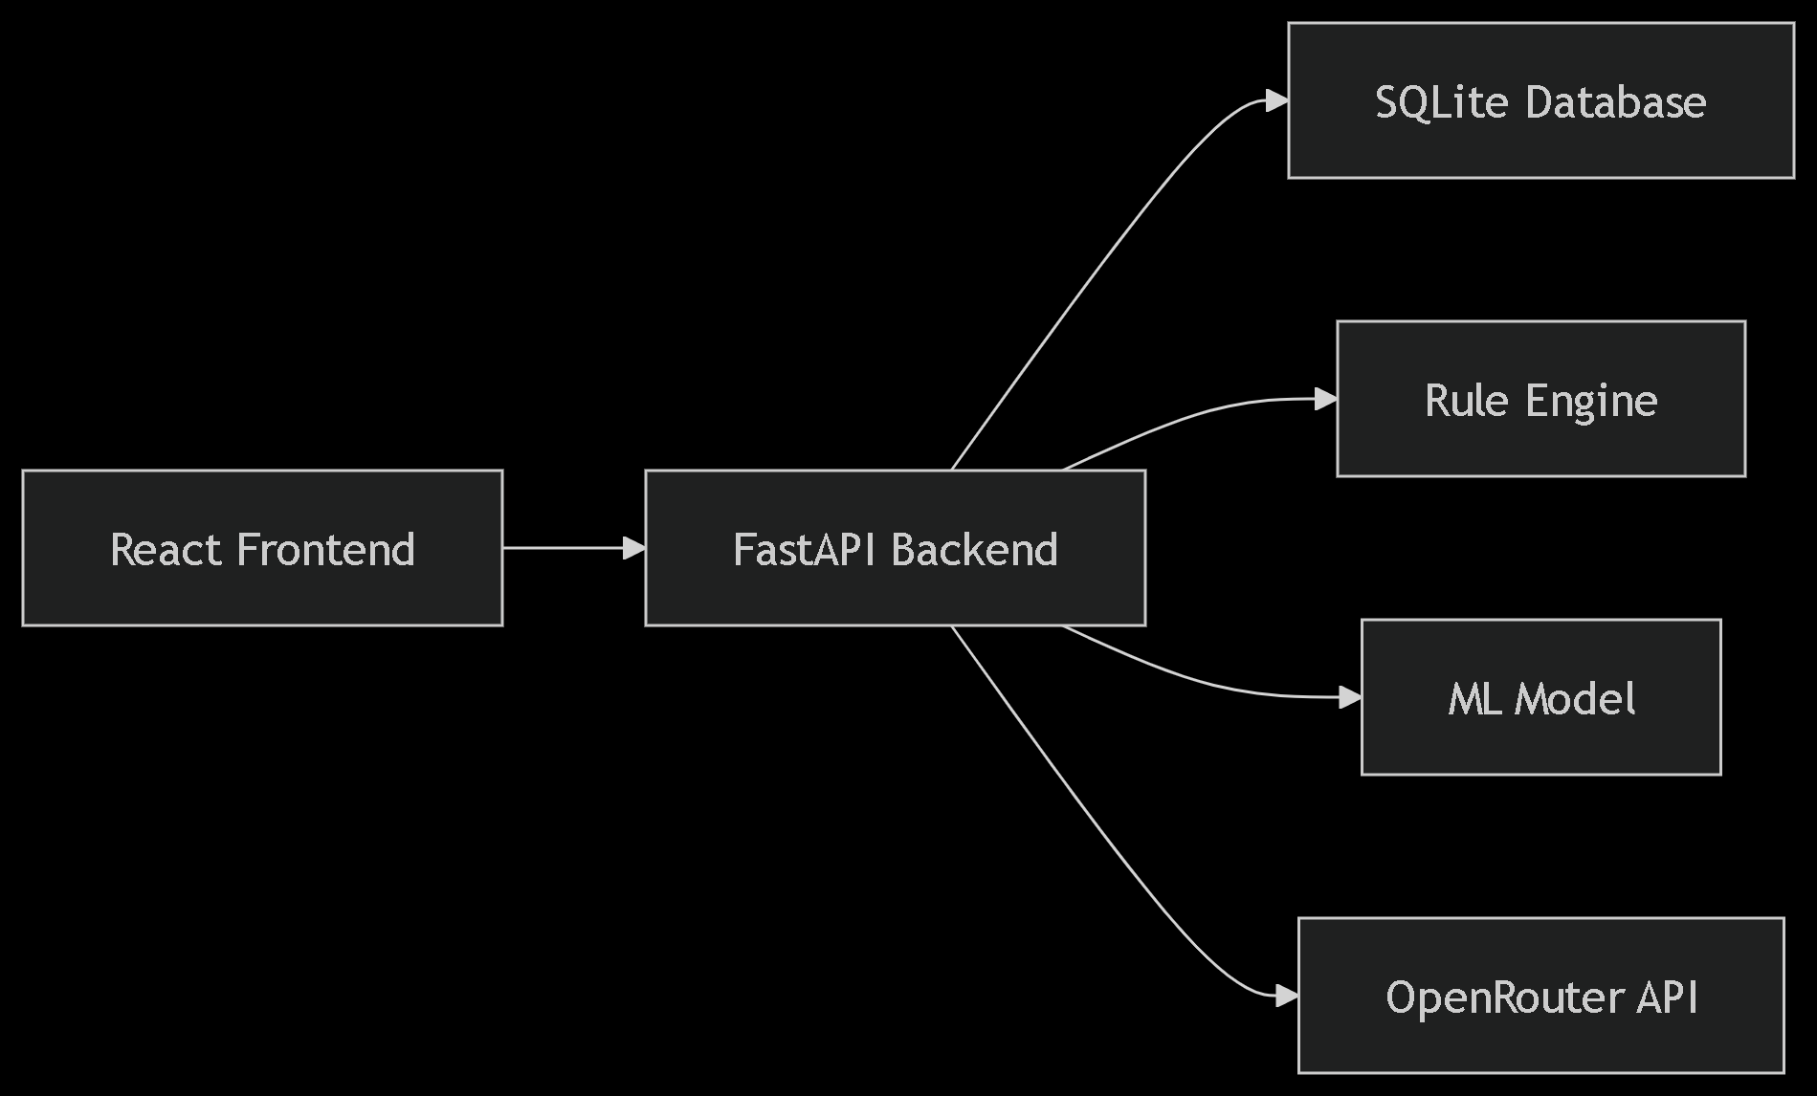
System architecture diagram:

Slide 4
System overview:
The AI Agent is a Dockerized full-stack application that assesses critical thinking skills using dual AI approaches (rule-based and ML-based). It features:
React.js frontend for test administration and results visualization
Fast API backend with SQLite database
Dual AI scoring system (Rule-based + Random Forest Classifier)
Open Router API integration for question generation and feedback

Slide 5
Technical stack:
Frontend | React.js, Material-UI
Backend | Fast API (Python)
DataBases | SQLite + PostgreSQL
AI Engine | Rule-Based + Random Forest
APIs | Open Router (GPT-3.5)
Deployment | Docker, Docker Compose

Slide 6
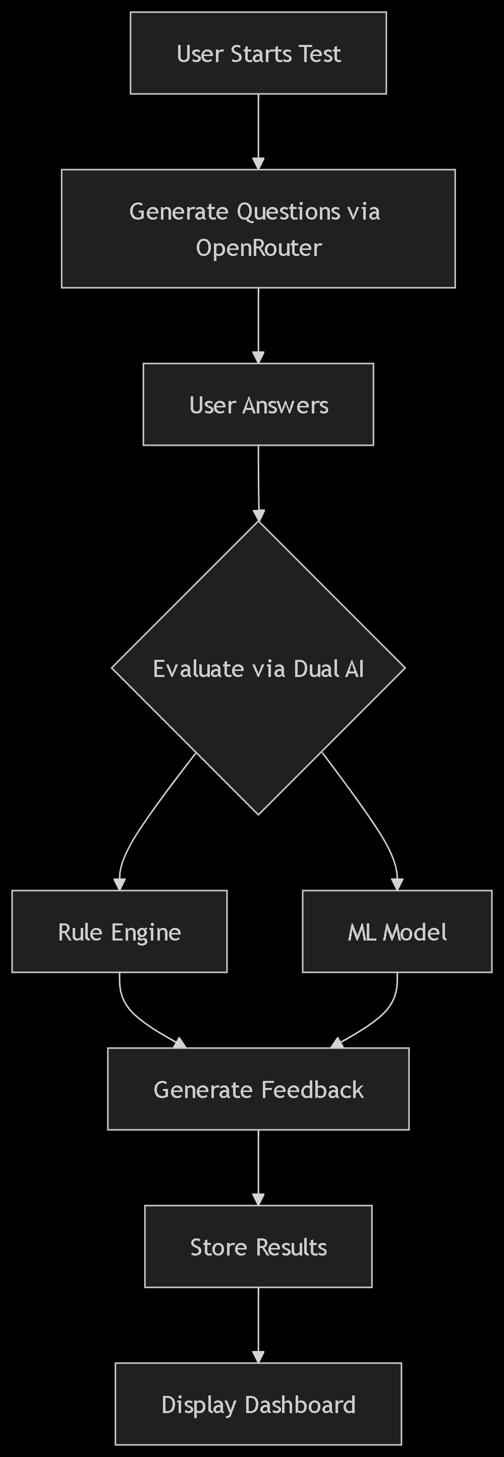
Ai decision-making process

Slide 7
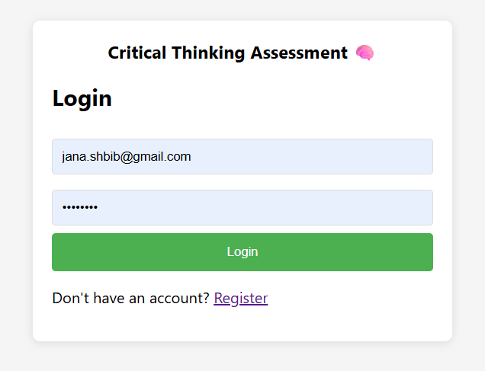
Demo walkthrough

Slide 8
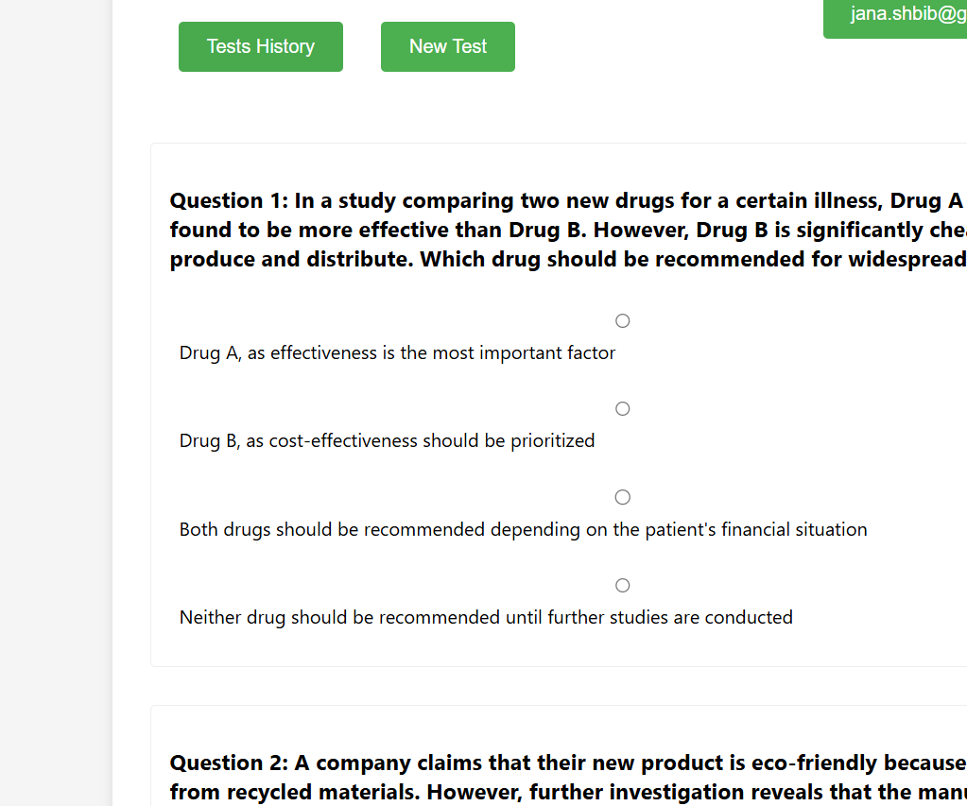
Demo walkthrough

Slide 9
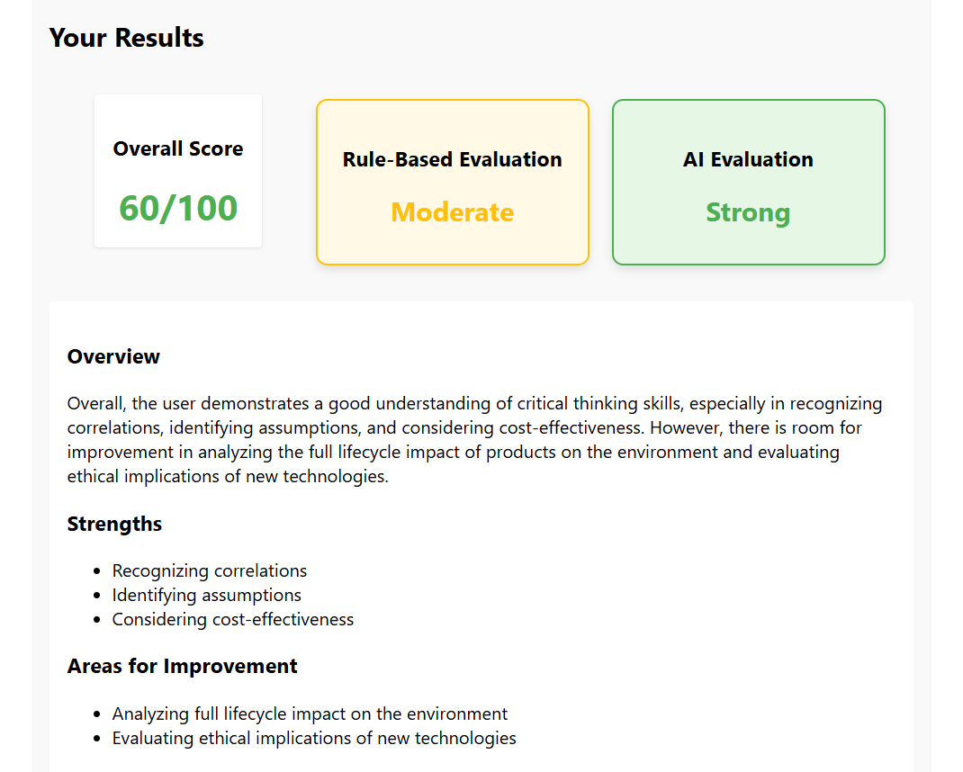
Demo walkthrough:

Slide 10
conclusion
This project demonstrates how hybrid AI can enhance education by making learning tools more intelligent, responsive, and accessible.

